Slide 1
C++ is Fun – Part Eight at Turbine/Warner Bros.!
Russell Hanson

Slide 2
Go over projects first!

Slide 3
For all you Black Jack-programming fiends:
http://courses.ischool.berkeley.edu/i90/f11/resources/chapter09/blackjack.py
# Blackjack
# From 1 to 7 players compete against a dealer
import cards, games
class BJ_Card(cards.Card):
""" A Blackjack Card. """
ACE_VALUE = 1
@property
def value(self):
if self.is_face_up:
v = BJ_Card.RANKS.index(self.rank) + 1
if v > 10:
v = 10
else:
v = None
return v
…

Slide 4
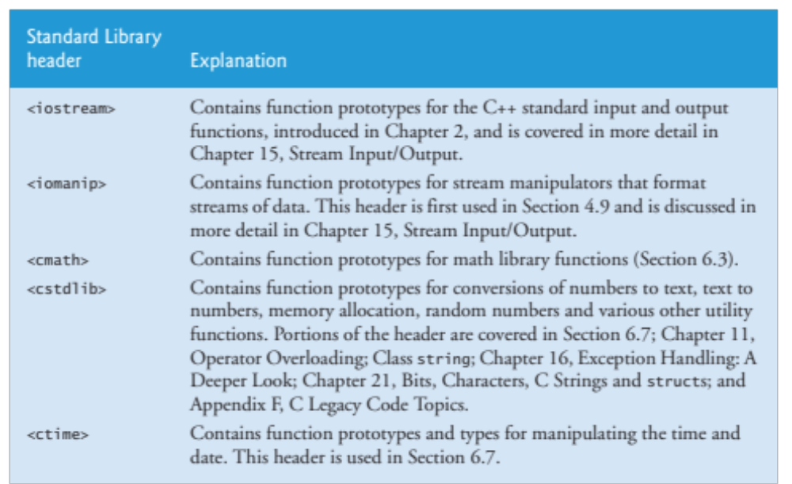
Overview of Standard Library headers

Slide 5
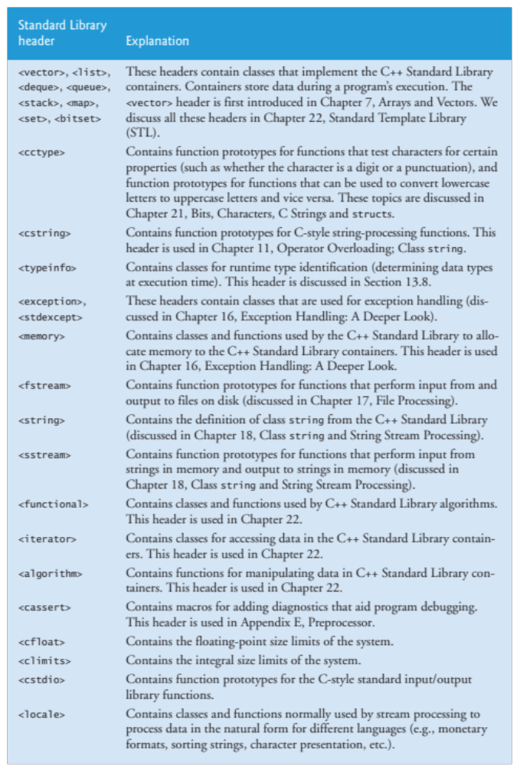

Slide 6
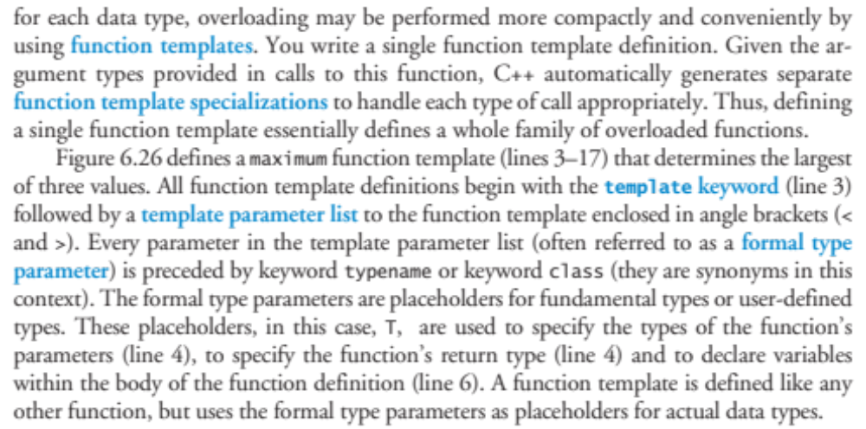
Function Templates

Slide 7
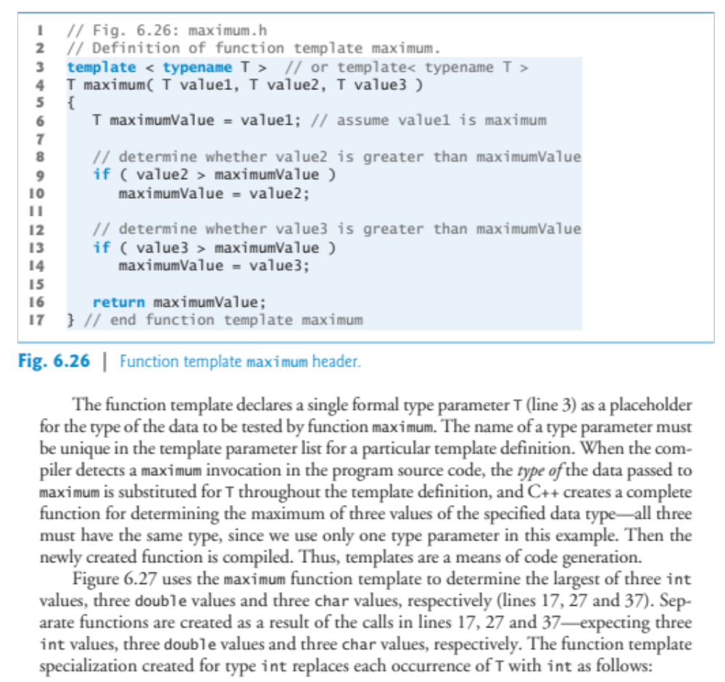

Slide 8
#include <iostream>
#include "maximum.h" // include definition of function template maximum
using namespace std;
int main()
{
// demonstrate maximum with int values
int int1, int2, int3;
cout << "Input three integer values: ";
cin >> int1 >> int2 >> int3;
// invoke int version of maximum
cout << "The maximum integer value is: "
<< maximum( int1, int2, int3 );
// demonstrate maximum with double values
double double1, double2, double3;
cout << "\n\nInput three double values: ";
cin >> double1 >> double2 >> double3;
// invoke double version of maximum
cout << "The maximum double value is: "
<< maximum( double1, double2, double3 );
// demonstrate maximum with char values
char char1, char2, char3;
cout << "\n\nInput three characters: ";
cin >> char1 >> char2 >> char3;
// invoke char version of maximum
cout << "The maximum character value is: "
<< maximum( char1, char2, char3 ) << endl;
} // end main
// Definition of function template maximum.
template < class T > // or template< typename T >
T maximum( T value1, T value2, T value3 )
{
T maximumValue = value1; // assume value1 is maximum
// determine whether value2 is greater than maximumValue
if ( value2 > maximumValue )
maximumValue = value2;
// determine whether value3 is greater than maximumValue
if ( value3 > maximumValue )
maximumValue = value3;
return maximumValue;
} // end function template maximum

Slide 9
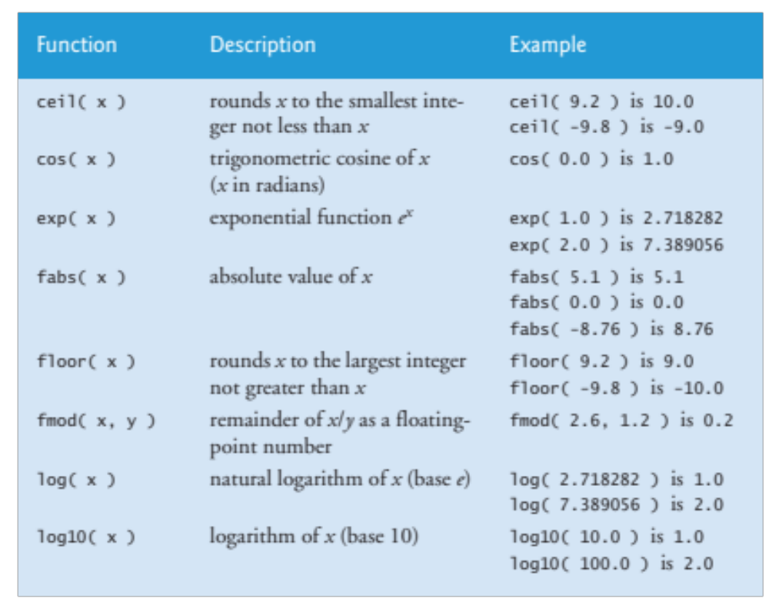
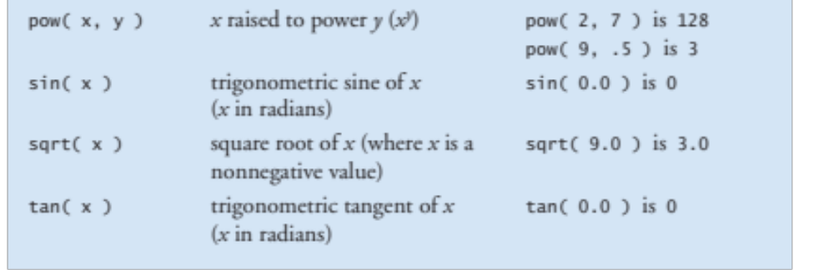
Math library fun-ctions

Slide 10
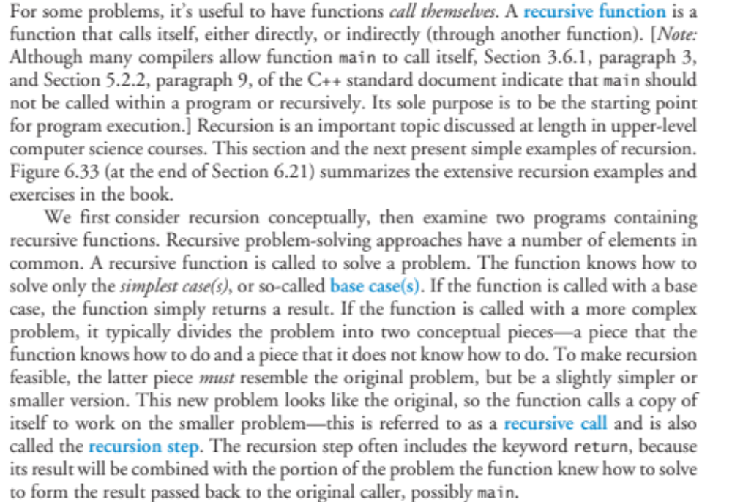
Recursion

Slide 11
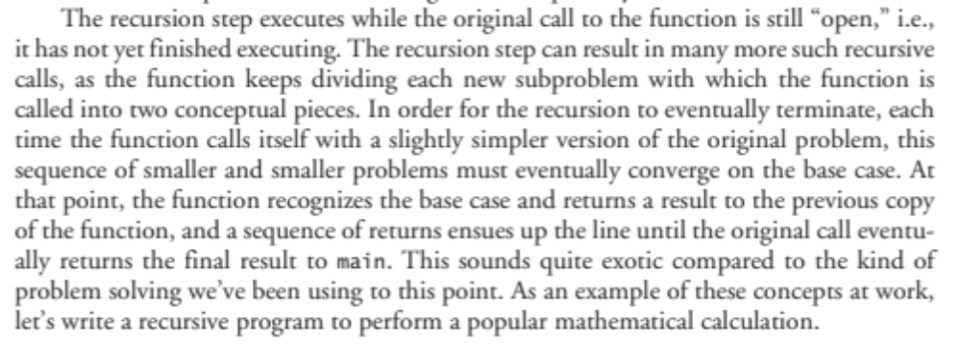

Slide 12
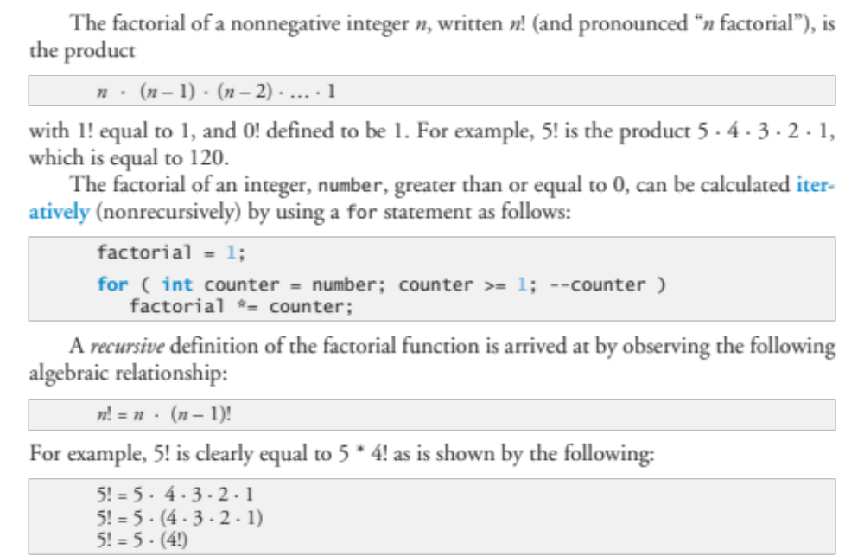

Slide 13
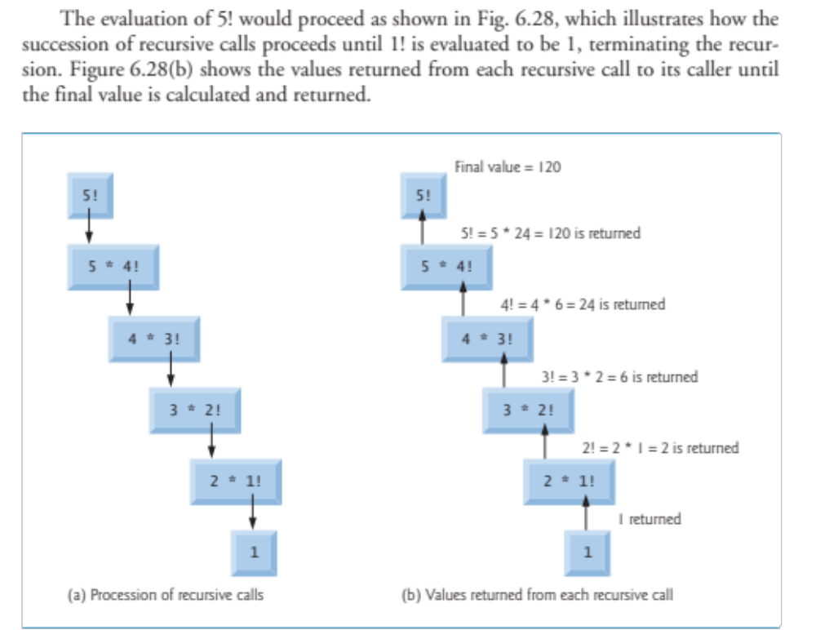

Slide 14
// Demonstrating the recursive function factorial.
#include <iostream>
#include <iomanip>
using namespace std;
unsigned long factorial( unsigned long ); // function prototype
int main()
{
// calculate the factorials of 0 through 10
for ( int counter = 0; counter <= 10; ++counter )
cout << setw( 2 ) << counter << "! = " << factorial( counter )
<< endl;
} // end main
// recursive definition of function factorial
unsigned long factorial( unsigned long number )
{
if ( number <= 1 ) // test for base case
return 1; // base cases: 0! = 1 and 1! = 1
else // recursion step
return number * factorial( number - 1 );
} // end function factorial

Slide 15
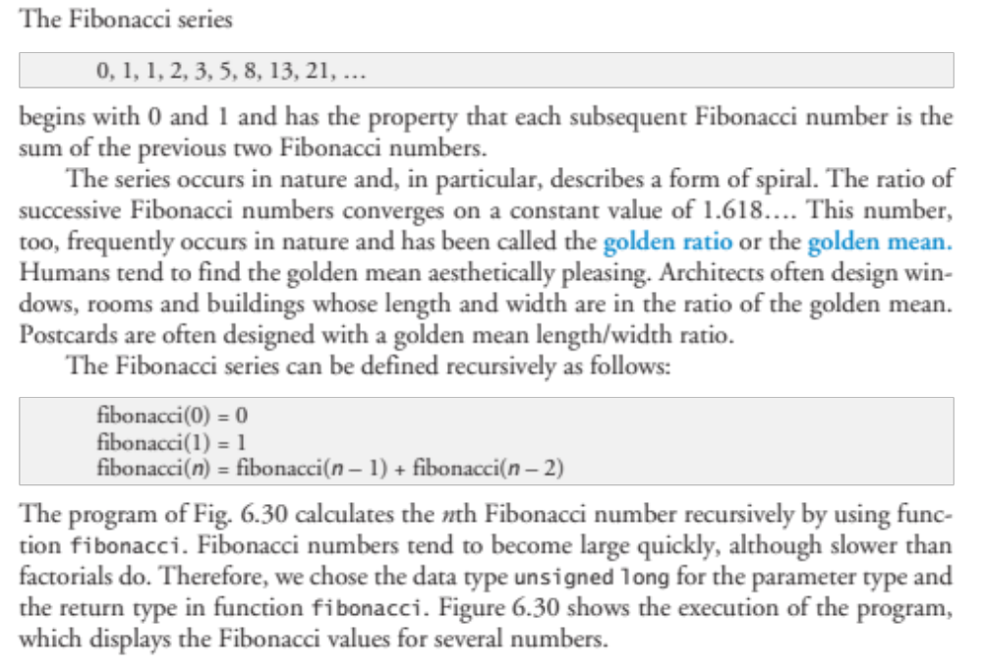
Another Example Recursion

Slide 16
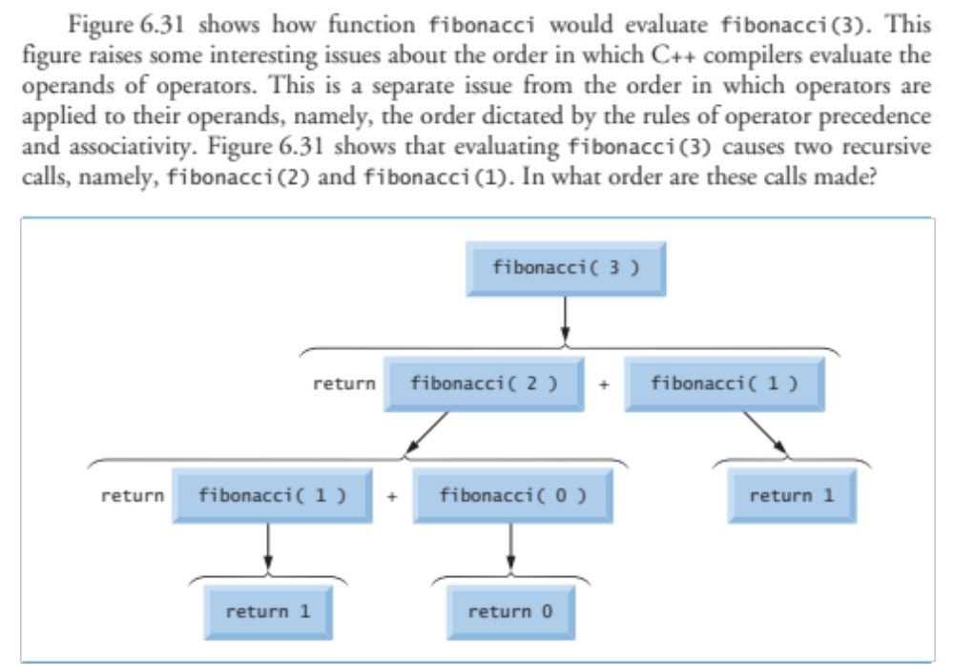

Slide 17
#include <iostream>
using namespace std;
unsigned long fibonacci( unsigned long ); // function prototype
int main()
{
// calculate the fibonacci values of 0 through 10
for ( int counter = 0; counter <= 10; ++counter )
cout << "fibonacci( " << counter << " ) = "
<< fibonacci( counter ) << endl;
// display higher fibonacci values
cout << "fibonacci( 20 ) = " << fibonacci( 20 ) << endl;
cout << "fibonacci( 30 ) = " << fibonacci( 30 ) << endl;
cout << "fibonacci( 35 ) = " << fibonacci( 35 ) << endl;
} // end main
// recursive function fibonacci
unsigned long fibonacci( unsigned long number )
{
if ( ( number == 0 ) || ( number == 1 ) ) // base cases
return number;
else // recursion step
return fibonacci( number - 1 ) + fibonacci( number - 2 );
} // end function fibonacci

Slide 18
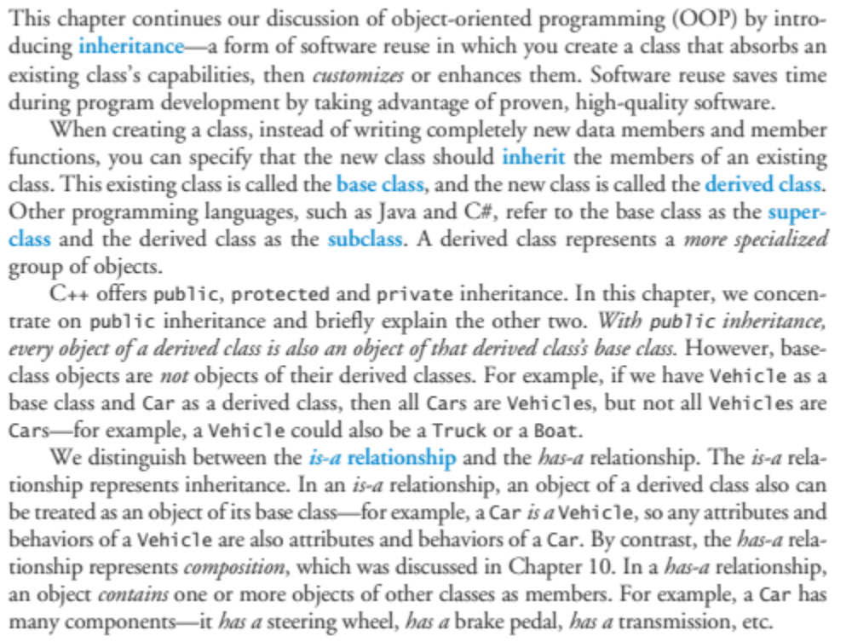
Inheritance

Slide 19
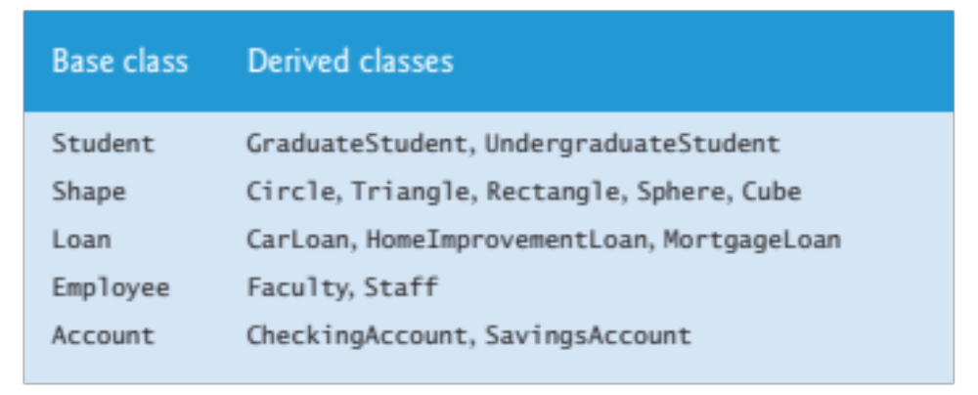

Slide 20
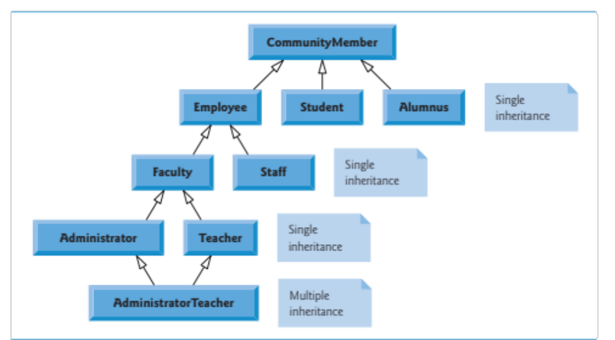
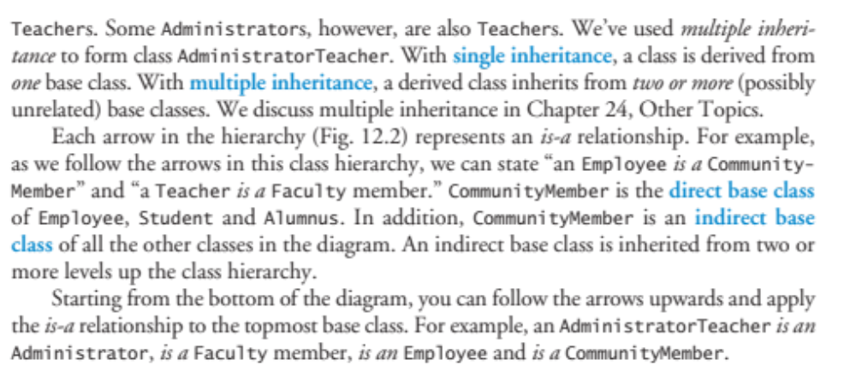

Slide 21
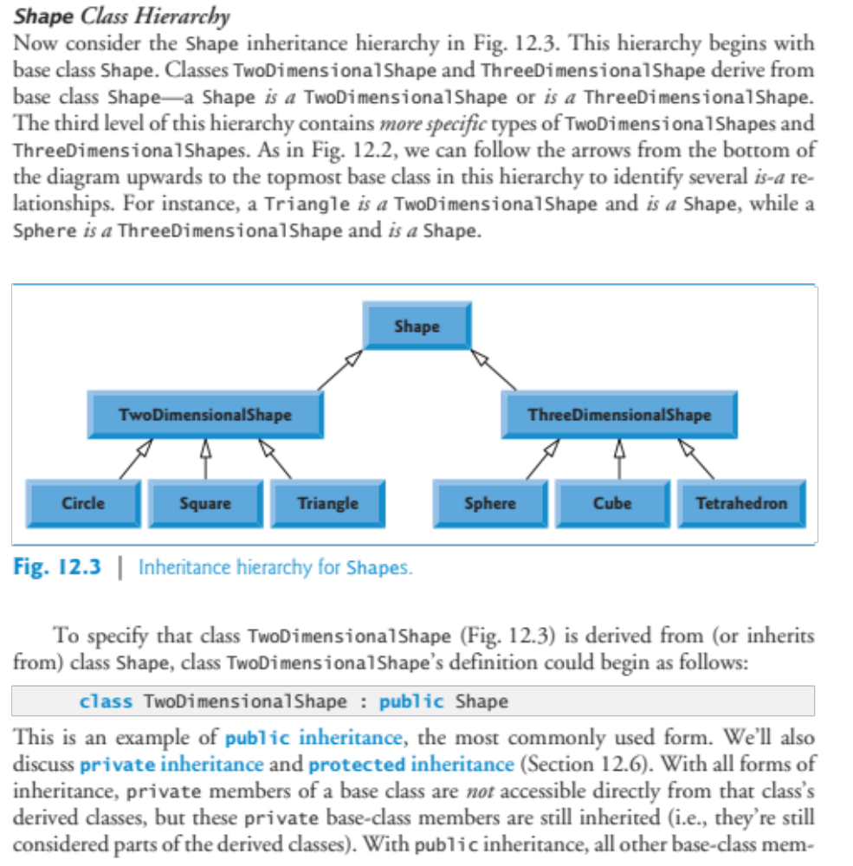

Slide 22
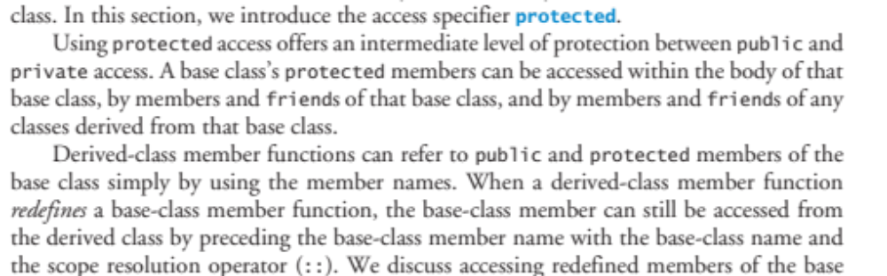

Slide 23
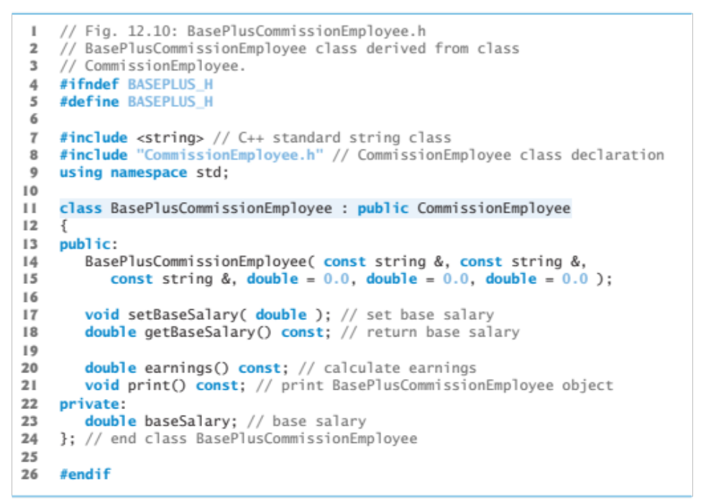
Why use inheritance?

Slide 24
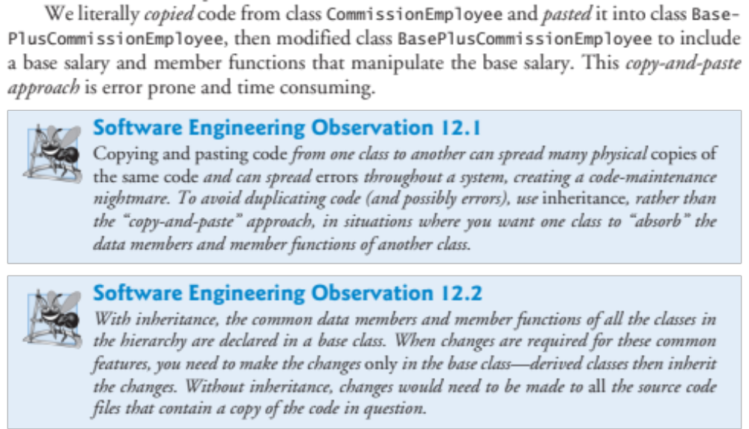
Why?

Slide 25
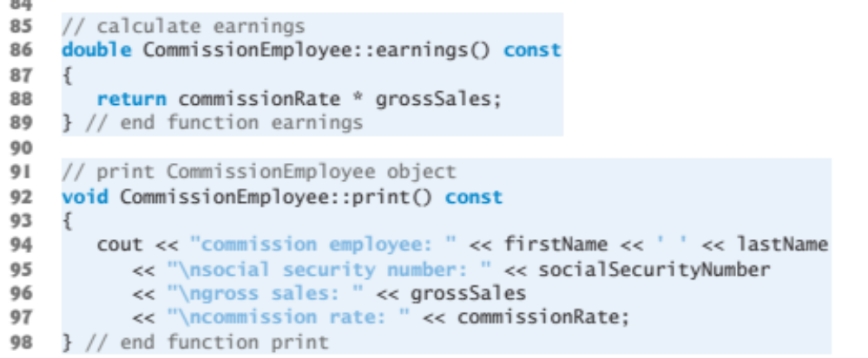
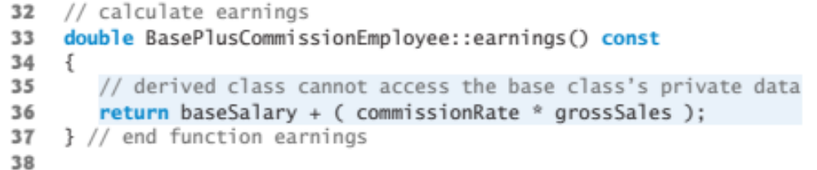
Why use inheritance? -- Just change one function

Slide 26
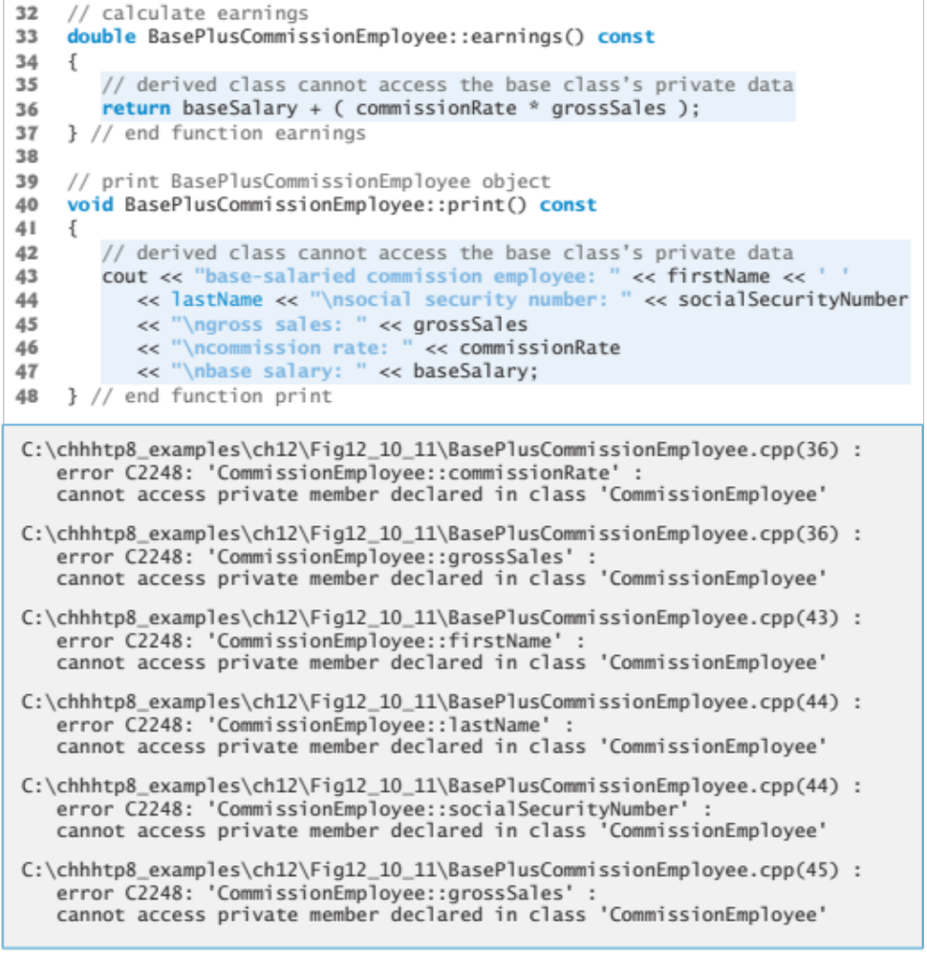

Slide 27
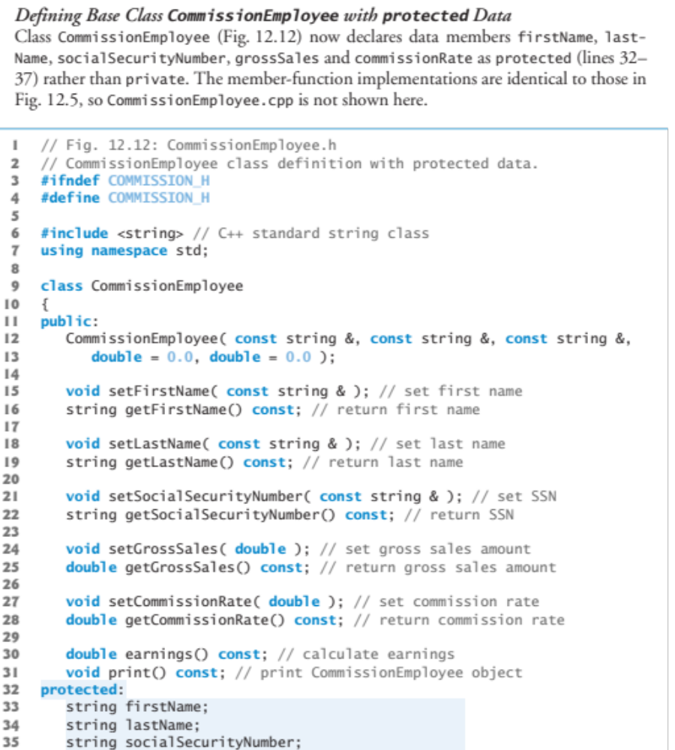
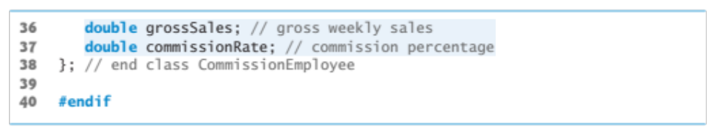

Slide 28
Class Exercise – Check the folder “CommissionEmployee” on Google Drive

Slide 29
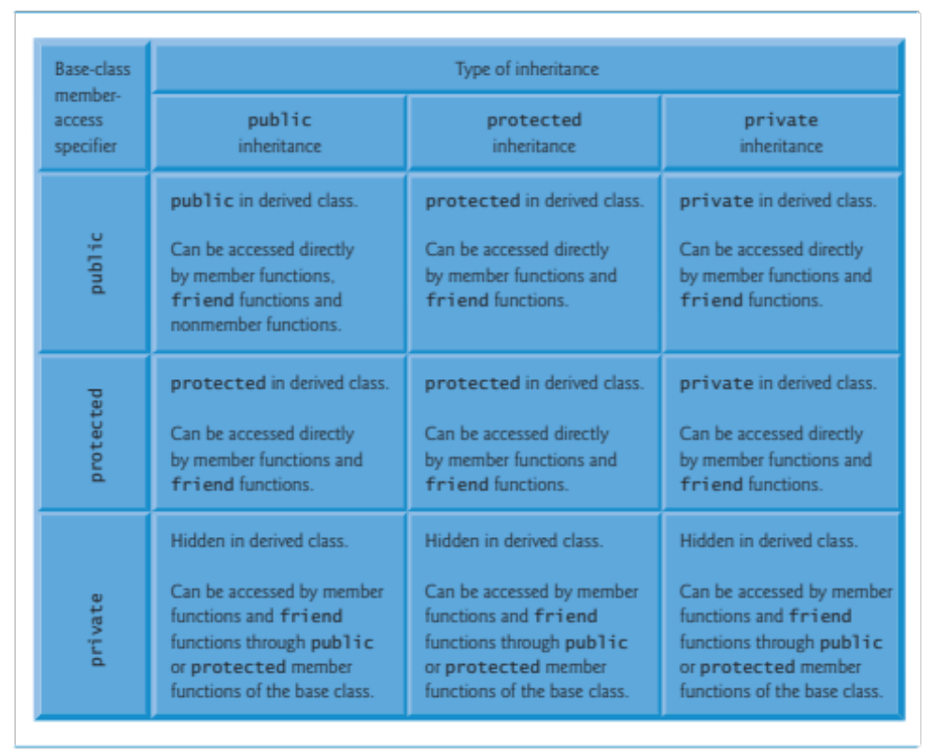

Slide 30
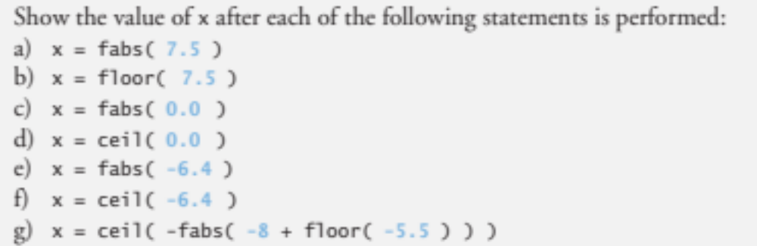
Homework Exercises (Pick 1)
Download and install either
http://www.appgamekit.com/ (2D only, but simpler)
OR
http://www.ogre3d.org/ . Compile, link, and run one of the sample programs.
2)
Implement a simple Tic Tac Toe “AI” strategy. Some sample implementations of the game are at the following two links:
http://courses.ischool.berkeley.edu/i90/f11/resources/chapter06/tic-tac-toe.py
http://en.literateprograms.org/Tic_Tac_Toe_(Python)
3)

Slide 31
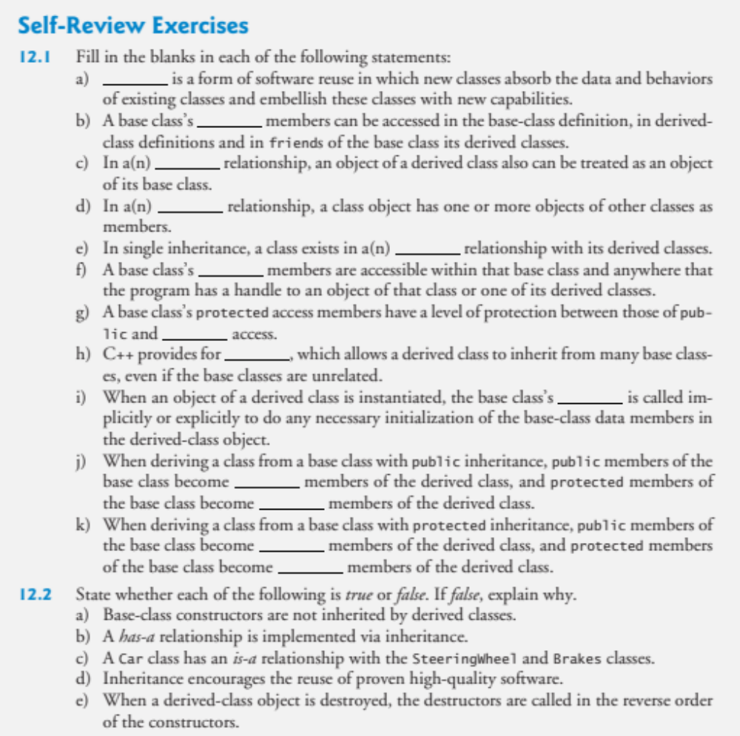
4)

